Slide 1
Come to the Dart Side
Why you should care about Flutter
ThomasBurkhart
Xamarin Expertday Cologne
19.10. 2018

Slide 2
“Flutter is Google’s mobile UI framework for crafting high-quality native interfaces on iOS and Android in record time. Flutter works with existing code, is used by developers and organizations around the world, and is free and open source.” - flutter.io

Slide 3
Key properties
Cross Platform App and UI Framework
Fast growing community
Fast: 60-120fps
Reactive architecture
Uses Dart
OSS
Easy to get start with

Slide 4

Xamarin Forms
Native OS
OEM Widgets
rendering
Canvas
Your
App
Xamarin Forms
Events
Mapping/ marshalling
Sensors
Location
Audio
Etc
Flutter
Your
App
Flutter
rendering
Canvas
Events
Sensors
Location
Plugins
Dart
Plugins
Java/obj-c
Audio
Etc
messages

Slide 5
High-level framework
Material
Cupertino
Framework
(Dart)
Complied to ARM code
Widgets
Rendering
Animation
Painting
Gestures
Foundation
Engine
(C++)
Skia
Dart VM
Text
Source: Flutter System Architecture

Slide 6
Advantages of Rendering all by itself
Extremely fast 60-120fps for animations
App looks the same on all platform down to the pixel
Does runs on every OS version without AppCompat libraries
Small App size due to Darts tree shaking linker. Flutter adds only about 4MB to your App
Fast App start-up because no scanning for custom renderers

Slide 7
What comes out of the box with Flutter
Reactive UI framework “inspired by React”
UI Test framework
CLI tooling
IDE support (VS Code, Android Studio, IntelliJ)
Stateful Hot Reload (It’s awesome, like, really, really awesome)
Prebuilt Material Design widget catalog
Performance tooling
The whole Dart ecosystem!

Slide 8

What is Dart?

Slide 9
void main() {
print('Hello Xamarin Expert Day!!');
}

Slide 10
import 'dart:async';
const oneSecond = const Duration(seconds: 1);
Future<Null> printWithDelay(String message) async {
await new Future.delayed(oneSecond);
print(message);
}
Future main() async {
await printWithDelay('Hello PHX Flutter & Dart Meetup!!');
}

Slide 11
What comes out of the box with Dart?
Fast Package manager
Deploys everywhere
Mobile
Web
Server
21st century language features
Async / await, streams, static typing, genrics
IDE Support
Intellij, Android Studio, Visual Studio Code on Windows, Mac, Linux
Static analysis, refactor, code completion, quick fixes, etc.
Constantly growing community

Slide 12
Dart features
Easy to pick up. C# developers can instantly start
Single threaded by default. Isolates don‘t share memory
Streams are part of the language
ASYNC/AWAIT
Compiles to:
JS Script
ARM Code
Can be interpreted
Not too complex but adds some nice language features
All packages are distributed as source code

Slide 13
Flutter fundamentals

Slide 14
What makes Flutter unique?
They rolled their own runtime
No dependency on OEM UI components
No need to use any marshalling/Pinvoke
Looks exactly the same on any platform down to the pixel.
No separate markdown language for expressing UIs
Runs on multiple platforms
Runs right on the metal
Everything is a Widget

Slide 15
Two modes of Flutter applications
Debug / Slow mode
JIT compiled for stateful hot reload and fast dev cycles
Release mode
AOT compiled for speed and app store deployment

Slide 16
Everything is a Widget
class DemoWidget extends StatelessWidget {
@override
Widget build(BuildContext context) {
return new Center(
child: new Text('Hello World!'),
);
}
}

Slide 17
Everything is a Widget
class DemoWidget extends StatefulWidget {
@override
_DemoWidgetState createState() => new _DemoWidgetState();
}
class _DemoWidgetState extends State<DemoWidget> {
@override
Widget build(BuildContext context) {
return new Center(
child: new Text('Hello World!'),
);
}
}

Slide 18
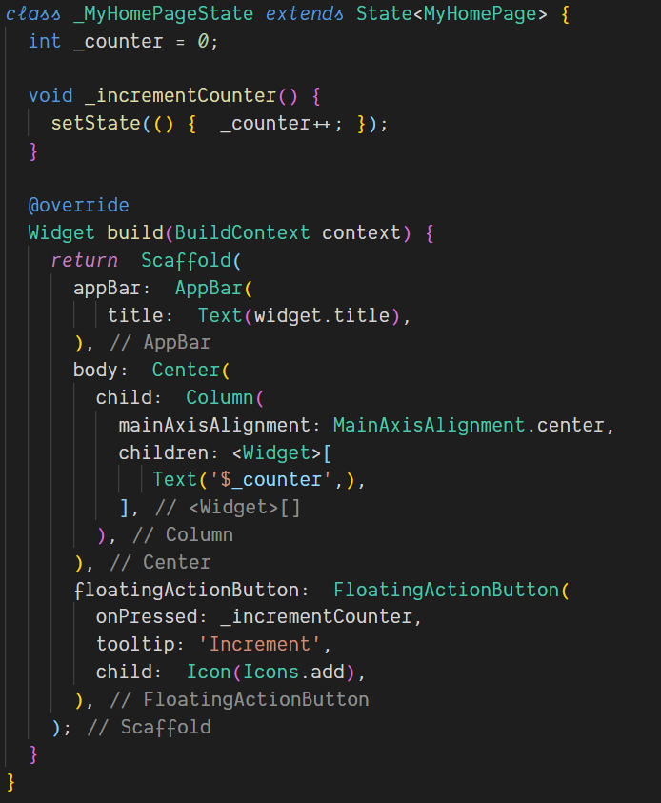
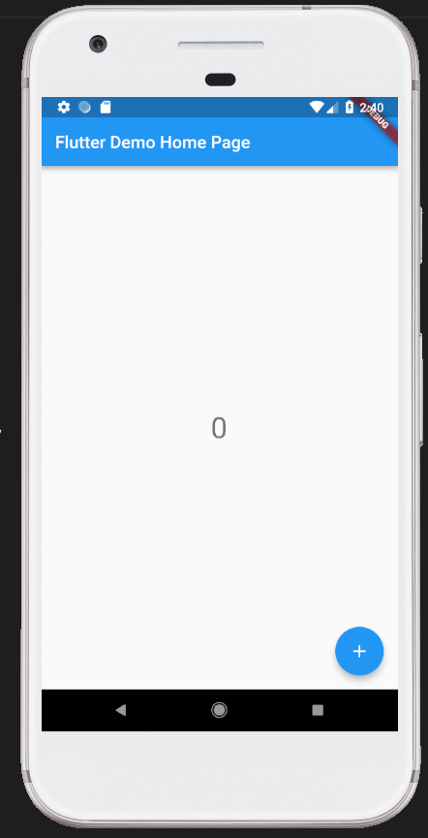

Slide 19
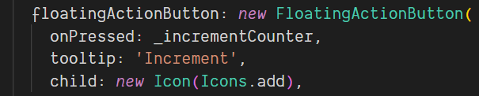
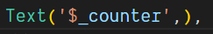
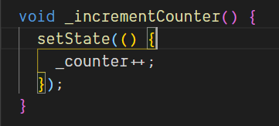
Why Flutter is called Reactive
Redraw updated widgets
User interaction
Read new state while rebuilding the widget tree
Update of state value
Trigger rebuild
Notes:
No data bindings between ViewModels and Views
Each data change triggers a redraw of the UI

Slide 20
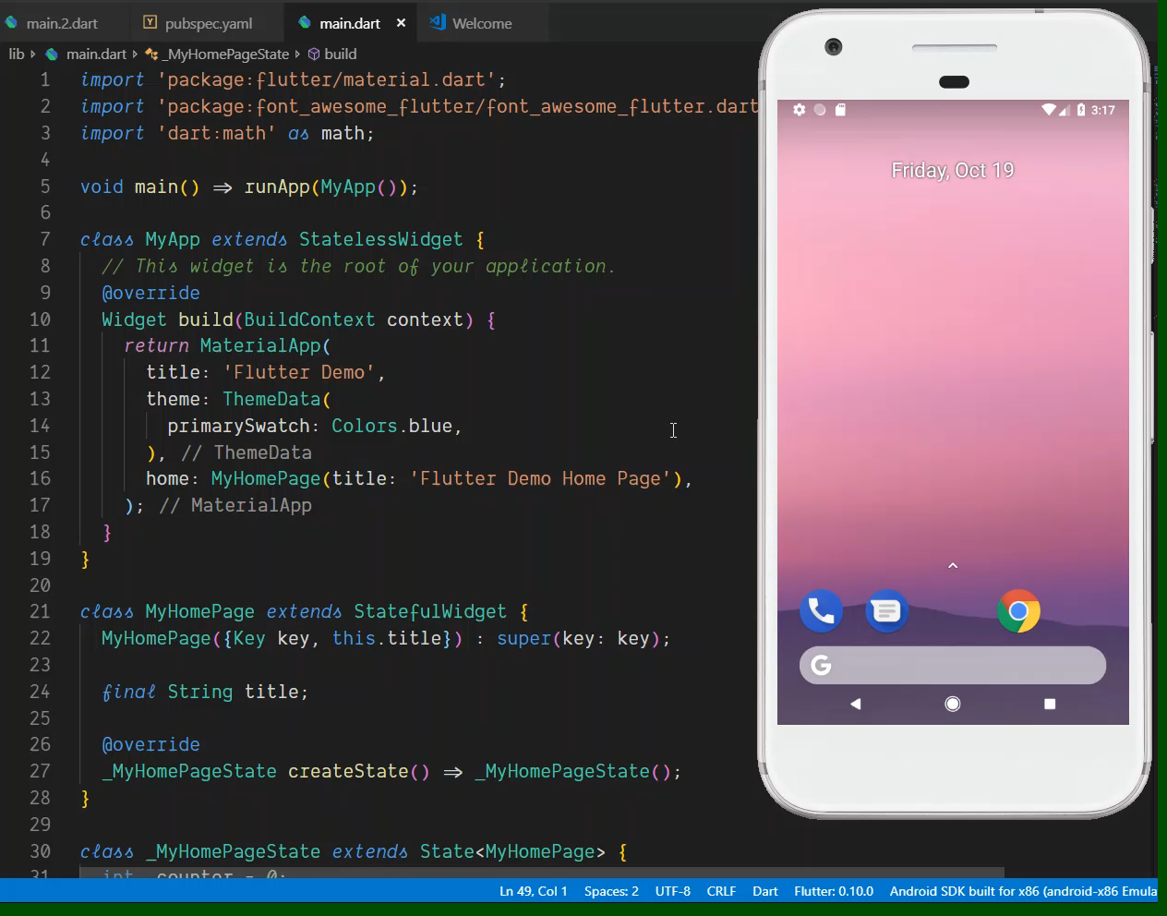

Slide 21
Getting started
Install Android SDK
Install your favorite IDE (VS code, Android Studio, IntelliJ)
Install Flutter plugins for your DIE
Clone the Flutter repo https://gitter.im/flutter/flutter
Add flutter/bin to your path
Run ‚flutter doctor‘
Create your first app with: flutter create your_app_name

Slide 22
Advantages of Flutter over Xamarin Forms
Very stable tool chain (at least if you don‘t use the master channel 😊 )
Animations with 60-120 FPS
Small App size
Fast startup time like native Apps
High productivity due to Hot Reload

Slide 23
A perfect cross platform world?
To access native APIs you need to write a native plugin in Java/Swift/obj-c
Still some plugins are missing but it‘s getting better
Intellisense in IDEs is not as far developed as in Visual Studio
No Azure SDKs currently

Slide 24
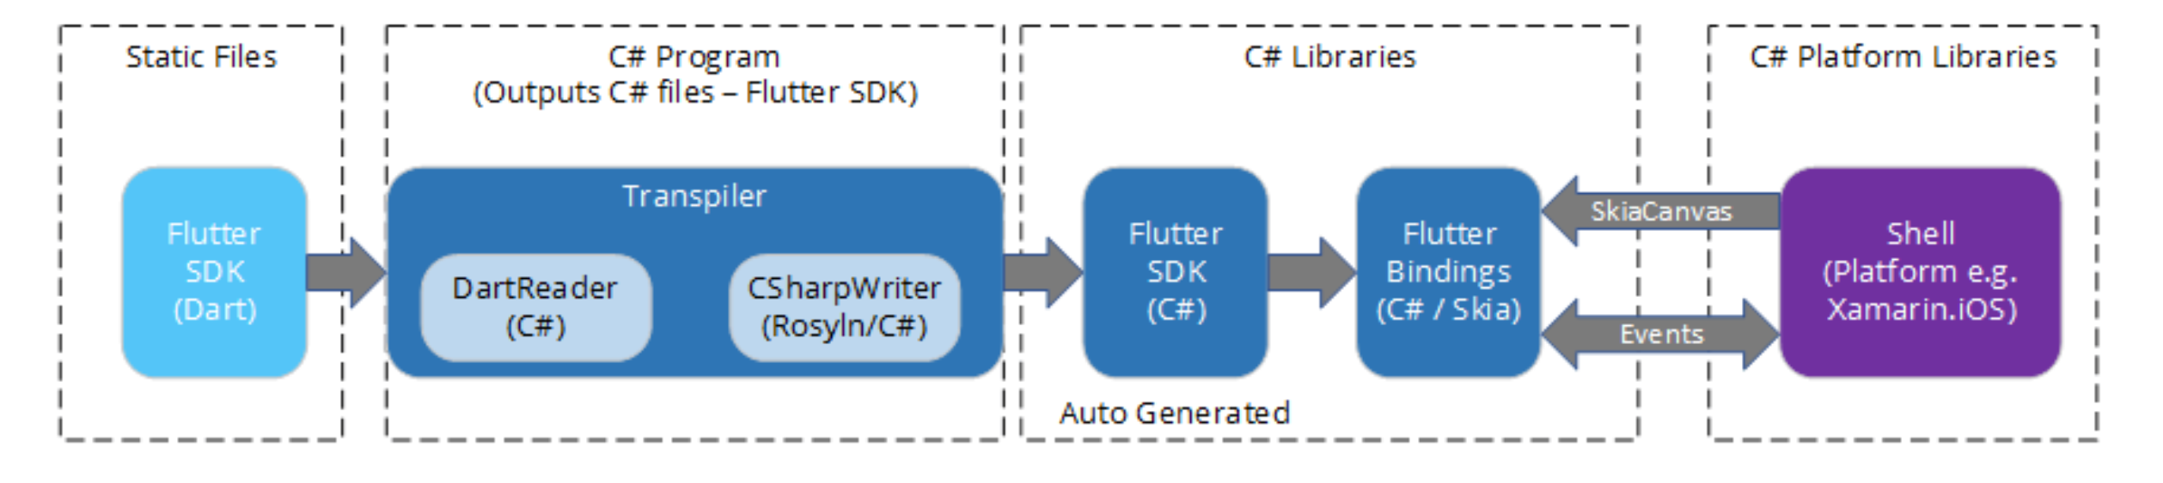
Latest Features and Outlook
Flutter Views embeded in native Apps
Native Views inside the Flutter Widget tree
Flutter on Linux, Mac and Windows
Flutter & Xamarin
Transpiling Flutter to C#: https://github.com/adamped/xamarin.flutter
Embedding native Flutter views in a Xamarin native App

Slide 25
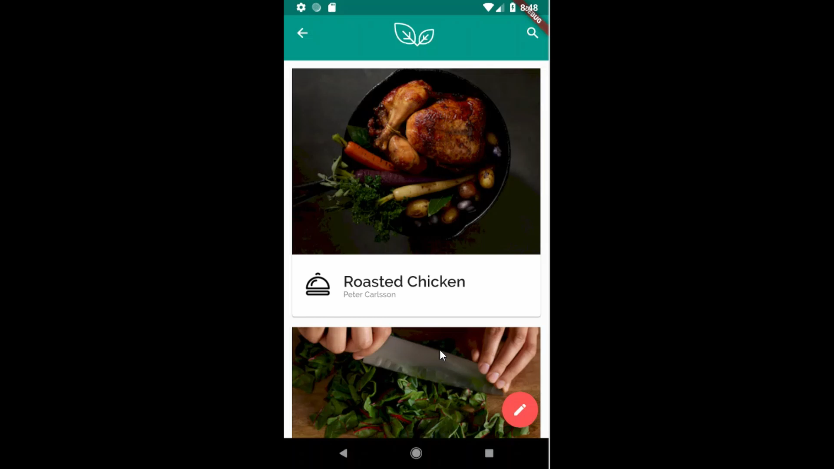

Slide 26
Resources
Find me in Twitter @thomasburkhartb
https://flutter.io/
https://github.com/flutter/flutter
My blog: https://www.burkharts.net/apps/blog/
Demos:
https://github.com/matthew-carroll/flutter_ui_challenge_egg_timer
https://github.com/MarcinusX/flutter_ui_challenge_flight_search
https://github.com/matthew-carroll/flutter_ui_challenge_material_page_reveal
https://github.com/matthew-carroll/flutter_ui_challenge_flip_carousel
https://github.com/matthew-carroll/flutter_ui_challenge_springy_slider
https://github.com/matthew-carroll/flutter_ui_challenge_weather

Slide 27
Questions?

